Slide 1
“Not Only SQL” Data Storage Options for .NET
Alex Garland

Slide 2


About Me
Senior Database Developer
-> MS SQL Server, Hadoop (HDFS)
Senior Data Engineer
-> Hadoop, Hive, Impala, Spark
www.alexdgarland.com www.twitter.com/alexdgarland
Notes:
Background in data analysis, management, development
(Not an expert on OOP/ ORMs!)

Slide 3
In This Presentation…
Theory
Comparison of database systems
Lots of code examples!
https://github.com/alexdgarland/database-demos
Architectures

Slide 4

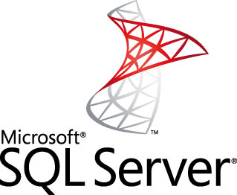


10 Years Ago
Application/“OLTP” Data Warehouse/ “OLAP”

Slide 5
Relational Dominance
1970s – Early 2000s
E.F. Codd - “A Relational Model of Data for Large Shared Data Banks”
Widespread Adoption, Heavy Vendor Investment

Slide 6
Relational – The Good Parts
Flexible - Good “All-Rounder”
Plain-English Query Language (SQL)
Strong Theoretical Basis (Maths/ Logic, ACID)
Mature Technology

Slide 7
So What’s Not To Like?
Programming Model:
Object-Relational Impedance Mismatch
Schema Changes
Separation of Skill-Sets/ Expertise
Scalability
Notes:
(Audience Participation)

Slide 8
Object-Relational Impedance
Fundamental difference in programming/ data model
ORMs – increased complexity, unreliable performance?
http://www.nogginbox.co.uk/blog/reviewing-my-data-access-using-entity-framework-profiler

Slide 9


Separate Skill-Sets
Developer
DBA

Slide 10
Separate Skill-Sets
“Can We …”
“No!”

Slide 11
Separate Skill-Sets
“We Need To Optimise …”
“We Don’t Have Time!”

Slide 12
Serialization
Standard, flexible way(s) to store objects
“Across-The-Wire”
Persistable
Binary – efficient but:
Hard to debug
Non-portable (although – Protocol Buffers, etc.)
Text
XML
JSON

Slide 13
Serializing to Relational Storage?
MS SQL Server – XML
PostgreSQL - JSON

Slide 14
So…
What About Scalability?

Slide 15


Vertical Scaling
Notes:
Vertical scaling means that when we are scoping a larger project, or adding capacity to an existing solution, we increase the resources allocated to each of one or more existing servers. So more/ more powerful CPU cores, more RAM, bigger and faster disks, etc.

Slide 16
Vertical Scaling
Simple – No Change to Fundamental Architecture
BUT:
Expensive – Non-Linear Cost Increases
Increasingly Specialist Hardware
No Redundancy

Slide 17
Horizontal Scaling
Notes:
The alternative is horizontal scaling. We don’t increase the size of the boxes but …
(SHOW ANIMATION)
…we use more of them.

Slide 18
Horizontal Scaling
Linear (or better) increases in cost to scale
BUT – increased complexity of architecture/ programming model
Especially challenging for data storage

Slide 19
Horizontal Scaling – “Read-Mostly”
Master-Slave Replication
Slaves
Read Traffic
Write Traffic
Load Balancer/ App Server(s)
Write Replication
Master
Notes:
The feasibility of scaling horizontally really depends on the required workload. If we’re dealing mostly with reads, we can use what’s called master-slave replication. Basically, there is still one definitive version of the data – the master – and all writes are sent there. We then push data out (replication techniques vary…) to copies of the master – these are the slaves. These multiple servers allow us to respond to many more read requests.
The key thing to note here is that there is still only a single server for the write workload, and if anything it is doing more work than before (it also has to do some sort of work to broadcast changes to the slaves). So if we have a lot of writes, we are going to either run into the same problems with vertical scaling as before, or need to move to an alternative (probably more complex) architecture.
NB: A “write-heavy” workload doesn’t need to mean a strict majority of requests are writes, just that there are enough that this architecture of having one master, many slaves is not going to work.

Slide 20
Horizontal Scaling – “Write-Heavy”
Database Sharding
Write Traffic
Read Traffic
Data Distribution Strategy
Shard A
Shard B
Shard C
Shard D
Notes:
One of the main ways that most database systems (including relational) can be scaled up horizontally for write workloads is through sharding.
At the highest level, sharding is relatively straightforward. We store distinct parts of the data on each of several nodes. Each node handles both reads and writes, so we can handle plenty of both types of traffic.
However – the devil is in the detail – what strategy do we use to distribute the data? – making sure our application knows where to send data to and retrieve it from? How do we make sure we keep data sufficiently and evenly distributed? This can add complexity to sharding, and traditional relational databases don’t always make this easy “out of the box”.

Slide 21
What is NOSQL?
#nosql - “No SQL” or “Not Only SQL”
Early 2000’s – “Web-Scale” companies
“Big Data” – 3 V’s
Volume
Variety (Structured, Unstructured)
Velocity
Tools for Massively Distributed Systems
Notes:
So now we’re starting to see some of the limitations of traditional database approaches. It’s time to focus a bit more clearly on what we mean by “NoSQL”.
Firstly, the term itself – it can be interpreted as excluding SQL and relational altogether, or the “NO” can be interpreted as meaning “Not Only”, implying a more mixed approach of the right database for the right problem.
This broader interpretation is probably more helpful for general-purpose usage.
The original idea of getting away from relational as the main storage medium came from “Web-Scale” companies like Google, Amazon and later social networks like Facebook.
They faced the challenge of building massive distributed systems with “Big Data” meeting the “Three Vs” conditions. This meant they were brought up sharply against the limits of relational databases.
These are companies that pride themselves on having highly-skilled engineering teams, so they started to build in-house systems which helped them manage data on this scale as well as maintain and scale clusters relatively easily. Some of their work (e.g. Google BigTable & GFS, Amazon Dynamo) was published as white papers and was an early influence on the wider NoSQL movement, which has grown since then
In particular there have been a number of freely-available open-source “NoSQL” systems created and released.

Slide 22
CAP Theorem
Eric A. Brewer.
“Towards robust distributed systems”
Principles of Distributed Computing, Portland, Oregon, July 2000
https://www.cs.berkeley.edu/~brewer/cs262b-2004/PODC-keynote.pdf
Seth Gilbert, Nancy Lynch
“Brewer’s Conjecture and the Feasibility of Consistent, Available, Partition-Tolerant Web Services”
ACM SIGACT News Volume 33 Issue 2, June 2002
http://webpages.cs.luc.edu/~pld/353/gilbert_lynch_brewer_proof.pdf

Slide 23
CAP Theorem
We can guarantee (at most) two of:
Consistency
Availability
Partition Tolerance
Notes:
This is the CAP theorem in its simplest form. So at face value at least, a classic engineering trade-off – “pick any two”.
We’ll need to unpack this a little bit more, particularly to understand what we mean by these three properties.

Slide 24
Consistency
All nodes see the same data/ history
Various strengths of consistency guarantee
e.g. http://www.bailis.org/blog/linearizability-versus-serializability
Notes:
Consistency is not the same as the “Consistency” of ACID database properties (which is more to do with logical integrity and invariants). CAP “Consistency” is closer to ACID “Isolation” – we get some level of ability to reason about data as if it were being acted on sequentially on a single machine.

Slide 25
Availability
All non-failed nodes must be able to respond to any request
Tends to be associated with (but not the same as) low latency
Notes:
High latency/ delay is impossible to cleanly identify vs complete failure, non-availability.
At extreme - latency approaching infinity [or operationally, some unacceptably high value - timeouts/ SLAs etc.] is effectively equivalent to non-availability.

Slide 26
Partition Tolerance
System can operate in conditions where nodes may fail or be unable to communicate
All real distributed systems MUST be partition-tolerant
So – choose CP or AP
blog.cloudera.com/blog/2010/04/cap-confusion-problems-with-partition-tolerance
Notes:
Practically speaking, any real-world distributed system must deal with the possibility of failure – delay in network communication, server garbage collection etc. count just as much as complete network partition/ node failure.
& the larger the system gets, the more expected hardware failures become. E.g. mean time to server failure = 3 years –> with 1000 servers you expect to average around 1 failure per day.
So in reality we have to decide, when these failures (“partitions”) happen, do we favour consistency or availability – the other cannot be guaranteed.

Slide 27
CAP – A Simple Example
Network partition
a = 1
UPDATE: a = 3
a = 1
a = 1
a = 1
a = 1
UPDATE: a = 2
Notes:
So to give a simple example – say we have five nodes which are collaborating to manage the same data. They might be part of a wider cluster, but these five all contain a record of the value for “a”. At first, all the nodes can communicate happily – and so if there is a change to the value of “a”, they all know about it and stay in sync with minimal latency.
HOWEVER (ANIMATION 1) – if we split them in half with a network partition, we have more of a problem. Not all the nodes can share information. If an update comes in during the partition (ANIMATION 2), we have a choice:
Allow the write on the nodes that can receive it. That means these nodes on the bottom right can get the new value and acknowledge success to the application. This is favouring availability, but then these nodes have a different value from those on the top left, so losing consistency. This is especially a problem if we also get a new update to the top-left partition (ANIMATION 3) – now we don’t even have a consistent HISTORY of updates – when the partition heals, we have to decide which update to keep/ which is the latest in the global “history”.
Alternatively, we can delay acknowledging and committing the write until all nodes can respond. This preserves consistency (all nodes have value 1, up until the point they can all accept value 2) but means we cannot write data while the network is partitioned – so availability is lost.
Traditional databases tend to be CP (favouring consistency) – one of the key insights of the NoSQL movement is that sometimes it is possible – and desirable - to favour availability.

Slide 28
So - Two Questions When Picking A Database:
Consistent (“CP”) or Available (“AP”)?
What Data Model?

Slide 29
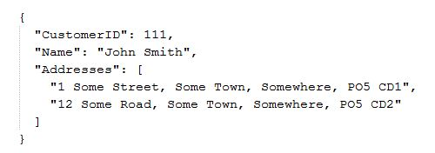
Document Databases
Store data as JSON documents
Straightforward, flexible object storage

Slide 30
Document Databases
Less good at:
Protecting data integrity
Summary queries
Different CAP trade-offs
e.g.
CouchDB (AP)
MongoDB (CP)

Slide 31

MongoDB
Open-Source Document Database
“CP” – Favours Consistency
BUT – Still Makes Distributed Storage Easier
Notes:
Using this new terminology, we can take a look at some “proper” NoSQL systems and categorise them accordingly.
MongoDB is a common (and reasonably good) place for developers to start with NoSQL, as it is decent at scaling up while still being basically “CP”, and (perhaps more importantly to many devs!) it avoids the impedance problems of relational DBs by storing data as BSON (binary JSON) documents.

Slide 32
(MongoDB Demo)

Slide 33
“AP” Systems – Riak & Cassandra
Also “Aggregate” data models – avoid joins
Highly optimised for availability
Based on Amazon “Dynamo” paper
Tunable AP/ CP trade-offs

Slide 34
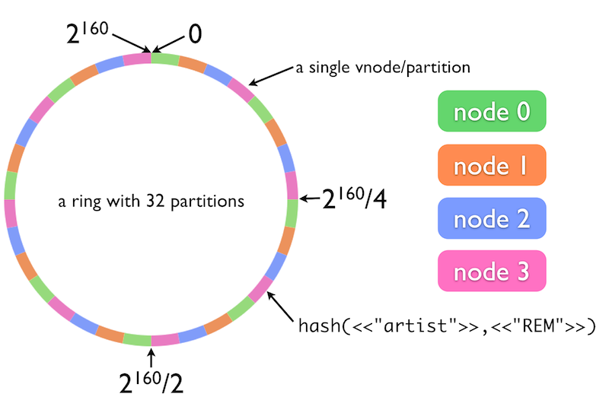
The Ring Model
http://docs.basho.com/riak/latest/theory/concepts/
Notes:
This is a model for data and load distribution that is shared by Riak and Cassandra (diagram is from Basho (Riak) website – but same principle), and has a deep impact on how they store, manage and retrieve data.

Slide 35
Tunable Consistency
Immediate vs Eventual
N, R & W Values – Strong, Quorum, Weak
“Read-Your-Writes”
Notes:
http://docs.basho.com/riak/latest/dev/advanced/cap-controls/
http://docs.basho.com/riak/1.1.0/references/appendices/concepts/Eventual-Consistency/

Slide 36

N, R & W
b = 10
c = 20
a = 1
a = 1
a = 2
b = 10
c = 20
a = 2
a = 1
b = 10
c = 20
N (total replicas) = 3
Satisfies W =
(minimum acknowledged writes)
1
2

Slide 37


Riak
Distributed Key-Value Store
Value = Any Binary Data
Open-Source
Developed/ Supported by Basho
Linux/ Erlang

Slide 38
(Riak Demo)

Slide 39


Apache Cassandra
AP Store for Structured (Column-Family) Data
Supported by DataStax
Free training - www.datastax.com/what-we-offer/products-services/training
Cassandra Query Language
Thrift -> CQL1 -> CQL2 -> CQL3
Model (superficially) similar to relational

Slide 40
(Cassandra Demo)

Slide 41
Cassandra Data Modelling
www.youtube.com/user/PlanetCassandra/search?query=model
No Joins
Write Multiple Copies/ Views of Data
Row Storage Model(s)

Slide 42
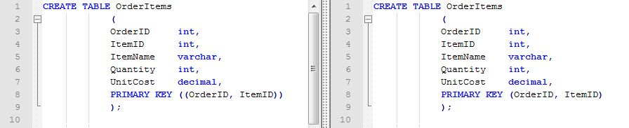
Cassandra Row Storage
Spot The Difference:

Slide 43

Cassandra Row Storage
Composite Row (Partition) Key
PRIMARY KEY ((OrderID, ItemID))
“Wide Rows” PRIMARY KEY (OrderID, ItemID)

Slide 44


Cloud Hosting
Amazon Web Services
Relational Database Service
Oracle/ MS SQL / MySQL/ Postgres/ Aurora, Read-Scaling
NoSQL
DynamoDB (Document/ Key-Value)
EC2 Hosting – MongoDB, Couchbase, other …
Google Cloud Platform
“Cloud SQL” (MySQL)
Cloud DataStore. BigQuery, DataFlow etc.

Slide 45

Cloud Hosting – MS Azure
Relational
NoSQL
DataStax Cassandra
Redis Cache
MongoLab
DocumentDB
Analytics
Hadoop – HDInsight, Cloudera
Machine Learning Services

Slide 46
DocumentDB (MS Azure)
Proprietary Microsoft NoSQL DB
JSON document format
Tunable Consistency
Caveats:
In preview
Vendor lock-in

Slide 47
(DocumentDB Demo)

Slide 48




Hadoop
Basis - GFS, MapReduce etc.
Yahoo! – Doug Cutting
Apache Top-Level Project
“Big” Data-Warehousing (++)

Slide 49
Distributed File System (HDFS)
Distributed, CP, Append-Only FileSystem
High-Latency Access/ ETL via Java MapReduce
vs. -> HBase
Basis for other analysis/ query tools

Slide 50
Hadoop – Core Tools
Local File System
Hive
Pig
(Java API)
Map
Reduce
PUT
GET
HDFS
Hadoop Distributed File System

Slide 51
MapReduce
Method of aggregating data from multiple nodes
“Send the work to the data”
Also implemented in Riak, MongoDB (etc.)

Slide 52
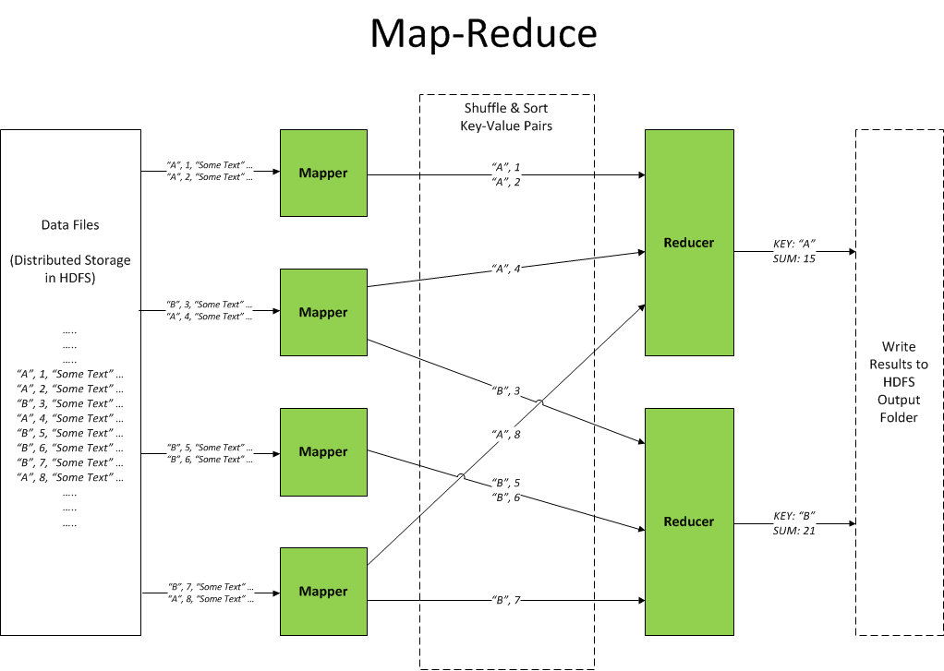

Slide 53
(Hadoop MapReduce Demo)

Slide 54


Hadoop Ecosystem
“Linux for Distributed Systems”
– HDFS, MapReduce, YARN
Related tools:
Hive, Pig, Spark, Impala, Mahout, Giraph, HBase, Cassandra, ZooKeeper, Ambari, Flume, Sqoop … (etc.) …
HortonWorks, Cloudera
3rd Party – e.g. HDInsight, SAS Visual Analytics

Slide 55

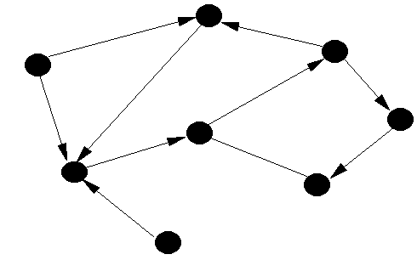
Graph Databases
Based on Graph Theory (Euler et al.)
Not relational – but not “standard” NoSQL

Slide 56

Neo4j
Easy to install, use
Expressive, flexible data model for related data
Use cases (YouTube playlist) - goo.gl/RrdQjp
ACID semantics, scalability limits as relational
More from me - http://alexdgarland.com/category/neo4j

Slide 57
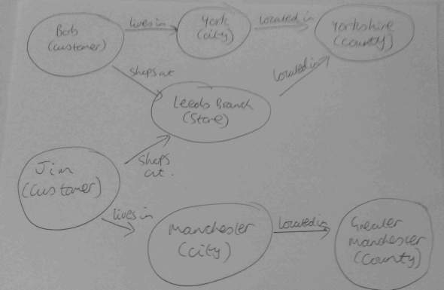
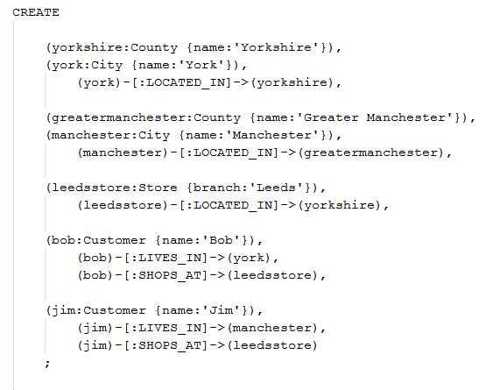
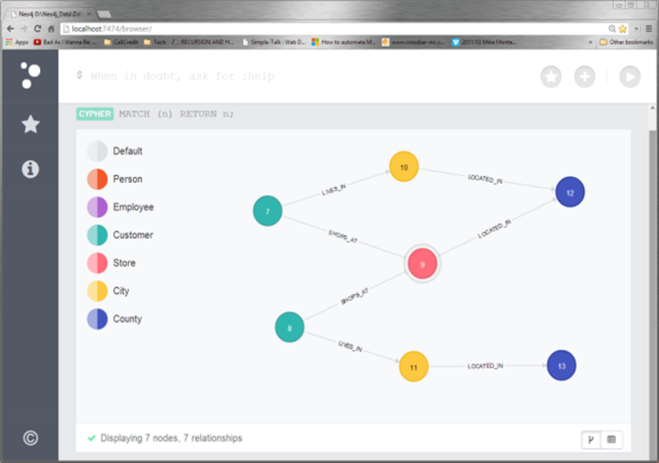
Neo4j – Data Model Design

Slide 58
Neo4j - Demo
Sketch -> Code -> Model
Client access (Neo4jClient)

Slide 59
Mixed Architectures
“Polyglot Persistence”
martinfowler.com/bliki/PolyglotPersistence.html
Different Business Processes
Read-Write Split:
Reporting Database
Data Warehousing
CQRS

Slide 60
Business Processes (Amazon)
“For the checkout process you always want to honor requests to add items to a shopping cart because it's revenue producing. In this case you choose high availability. Errors are hidden from the customer and sorted out later.”
“When a customer submits an order you favor consistency because several services--credit card processing, shipping and handling, reporting--are simultaneously accessing the data.”
highscalability.com/amazon-architecture

Slide 61
Reporting Systems
Old-World – OLTP vs OLAP – Relational
New-World :
Separate Analytics (Hadoop, etc.)
Integrate with (e.g.) Cassandra
Streaming Analytics
Lambda Architecture

Slide 62
CQRS
“Command-Query Responsibility Segregation”
Asking a question is not the same as making a change
NOT a specific architecture pattern
Can pair with “Event Sourcing” – commutative operations
Notes:
Event Stores ….
Quick note – commutativity is a really interesting approach to having AP systems without major consistency concerns, as we don’t need to worry about overall order of operations (serialisability) it makes “eventual consistency” more achievable and reliable. There are obviously some considerations around how this is implemented and when it’s a practicable approach, but for example Commutative Replicated Data Types are another way to apply it, more details (e.g.) here: http://highscalability.com/blog/2010/12/23/paper-crdts-consistency-without-concurrency-control.html

Slide 63
